Slide 1
Classical vs. Quantum Mechanics
Yuan Ping
Last Update: 9/11/24

Slide 2
Outline
Classical physics – what is it and when does it apply?
Classical length scales
Classical energy scales

Slide 3
Why Are We Talking About Classical Physics?
What is Classical Physics?
Theory for how particle motions and properties can be described
Not-quantum mechanical, largely developed pre-20th century (Newton, Hamilton, Maxwell, …), includes Mechanics and Electricity and Magnetism and Thermodynamics
An approximation to true quantum mechanical nature - applies accurately when length and energy scales of your problem are “big enough” to average over quantum effects
Describes a lot of the universe!
Classical physics (mechanics and electromagnetism) is often a good approximation for how atoms interact
Classical atomistic simulation methods (non-quantum) are founded in laws of classical physics – we will focus on studying laws that govern static equilibrium and dynamics (motion in time) of particles

Slide 4
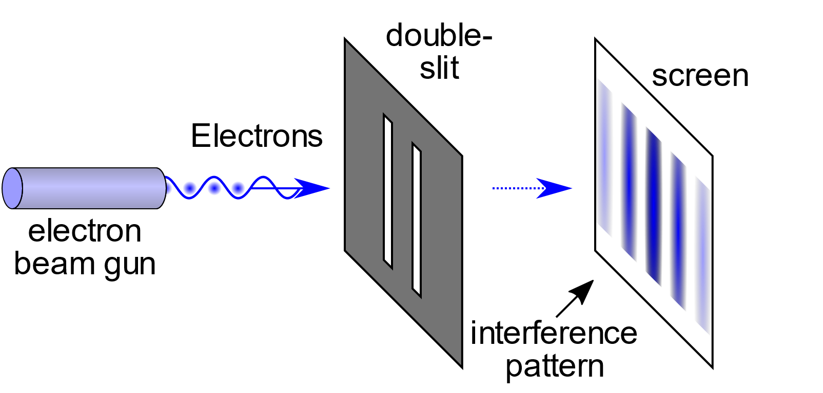
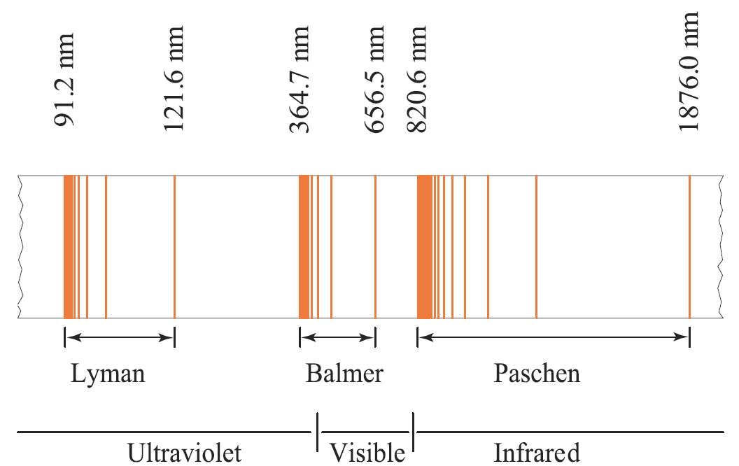
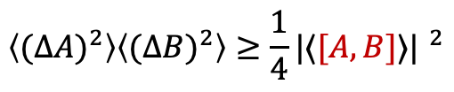

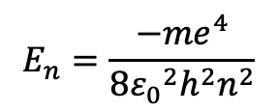

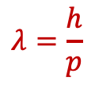
Quantum Mechanics
Double slit experiments
- particle-wave duality of matter
$$λ=\frac{h}{p}$$
(de Broglie $λ$)
Energy quantization
$$E_{n}=\frac{−{me}^{4}}{8{ε_{0}}^{2}h^{2}n^{2}}$$
H atom spectrum
Transitions between H atom energy levels
Uncertainty principles
$$ΔxΔp≥h$$
$$\left\langle {(∆A)}^{2}\right\rangle \left\langle {(∆B)}^{2}\right\rangle ≥\frac{1}{4}{|⟨[A,B]⟩| }^{2}$$
(general)

Slide 5
Classical Length Scales
A common length scale for the quantum effects is the De Broglie wavelength λ
λ represents the size of the quantum wave nature of the particle
quantum < λ < classical
E.g., if non-interacting gas particles have λ = 10 Å
In a box with sides >> 10 Å the particles will behave according to classical physics (e.g., <E> = 3kT)
In a box < 10 Å the particle will behave according to quantum physics (<E> ≠ 3kT)

Slide 6
De Broglie Wavelengths
Thermal De Broglie wavelength
T=300K)
Item | λ (Å)
e⁻ | 196
H | 4.6
Cu | 0.6
Electrons in an atom (~1 Å) are extremely quantum mechanical – no classical approximation describes them
H is semiclassical. Generally need to include some quantum effects (e.g., zero-point energy is standard)
Cu in a solid (interatomic distances ~3 Å) are well described classically (although not perfectly)

Slide 7
Classical Energy Scales
A common energy scale for the quantum effects is the separation between quantum energy levels, Δε.
Δε represents the energy scale over which discrete quantum states will influence properties
quantum < Δε < classical
E.g., consider a particle with vibrational states separated by Δε = 0.01 eV
At a temperature T = 300 K (corresponding to kT = 0.026 eV of thermal energy), the particle will behave more according to classical physics (e.g., <E> = 3kT)
At a temperature T = 30 K (corresponding to kT = 0.0026 eV of thermal energy), the particle will behave more according to quantum physics (e.g., <E> ≠ 3kT)

Slide 8
Quantum Energy Levels Δε
Item | Energy scale (eV)
Vibrational energy levels (Cu atom) | 0.010
Vibrational energy levels (H atom) | 0.060
First excitation energy of H electrons | 10.2
For reference: Thermal energy at T=300K | 0.026
Electrons in an atom (~1 Å) are extremely quantum mechanical – no classical approximation describes them
Vibration of H2 is semiclassical. Generally need to include some quantum effects (e.g., zero point energy is standard)
Vibration of Cu in a solid (interatomic distances ~3 Å) are well described classically (although not perfectly)

Slide 9
Summary
Classical physics is different than quantum physics but is a macroscopic limit of quantum mechanics.
Classical physics applies when length scales are “big enough” to average over quantum effects (> λ).
Classical physics applies when energy scales are “big enough” to average over quantum effects (> Δε).

